Slide 1
ASIC Physical Design
K.LOKESH
Chipweave Technologies Private Limited

Slide 2
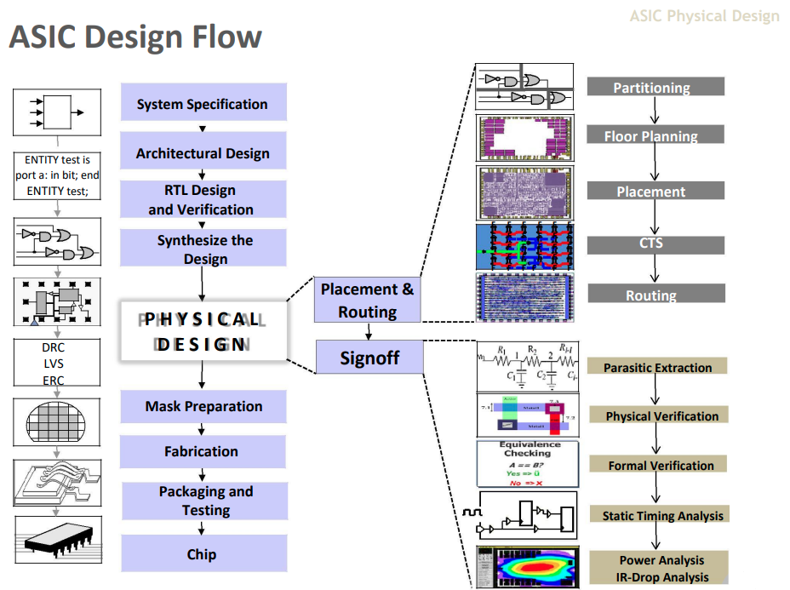

Slide 3
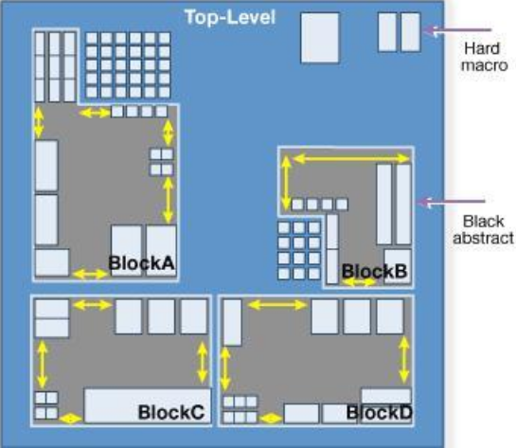
Partitioning
Partitioning is a process of dividing the chip into small blocks.
This is done mainly to separate different functional blocks and also to make placement and routing easier.
Partitioning Can Be Done Based On
  Design Hierarchy
  Timing Criticality
  Functionality
  Clock Domain
  Design Files
  Block Size
The goal of partitioning is to split the circuit such that the number of connections between partitions is minimized, providing a better layout and easier implementation.

Slide 4
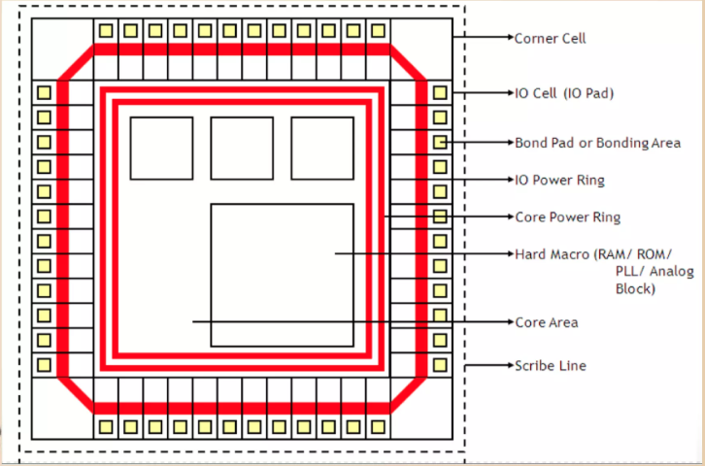
Floorplanning
Floorplanning is the process of placing blocks/macros in the chip/core area.
Objective of floorplanning are to minimize the area and delay.
The netlist is the logical description of the ASIC design. Floorplan is the physical description of the ASIC design. In floorplanning we are mapping the logical description of the design to the physical description.
Determine width and height of core and die.
Determine I/O pin placement.
Creating the Pad Ring for the Chip.
Determine location of predefined cell/macros.

Slide 5
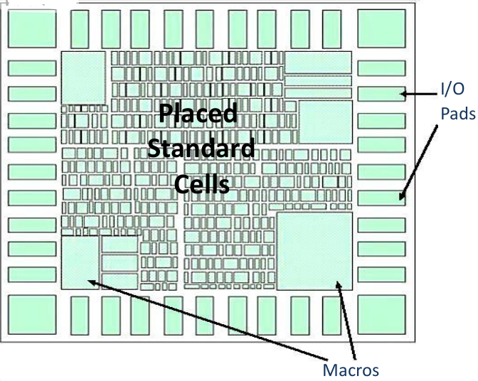
Placement
Placement is the process of placing standard cells in the design.
It also optimizes the design. Placement also determines the routability of your design.
Placement will be driven by different criteria like timing driven, congestion driven, power optimization.
Objective of placement is to optimize the area, timing, power and minimal timing DRCs and minimal cell and pin density.

Slide 6
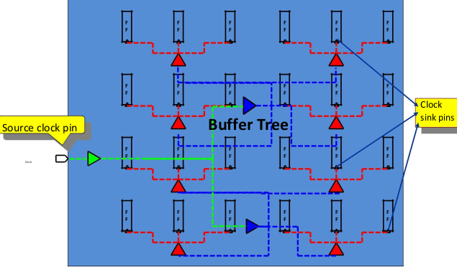
Clock Tree Synthesis (CTS)
Clock Tree Synthesis (CTS) is a process which make sure that the clock signals distributed uniformly to all sequential elements in a design.
CTS is the process of insertion of buffers or inverters along the clock paths of design in order to achieve minimum skew.
Objective of CTS
To meet clock tree design rule constraints
  such as maximum transition.
  maximum load capacitance and maximum fanout.
To meet clock tree targets
  such as minimum skew.
  minimum insertion delay.

Slide 7
Routing
It is a process determines the precise paths for interconnections.
Routing is nothing but connecting the various blocks in the chip with one an other.
After CTS, we have information about the exact location of placed cells, blockages, clock tree buffers/inverters and I/O pins. This information is important for tool to complete all the connections defined in netlist.
In routing stage, metal and vias are used to create the electrical connection in layout defined by logical connections present in netlist.
Objective of routing to meet the timing constraints, no LVS errors, no DRC errors and minimize the total wire length.
There are many stages in routing process:
  a)Global routing b)Track assignment
  c)Detailed routing d) search and repair.

Slide 8
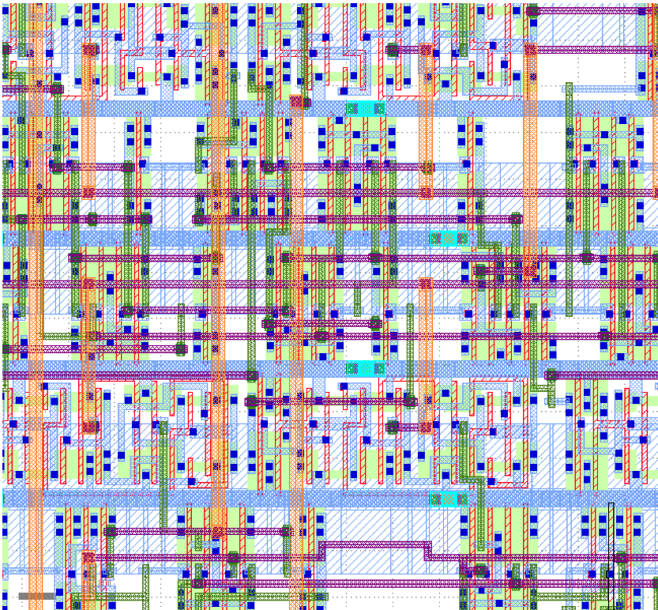
Routing

Slide 9
Physical Verification and Signoff
After routing stage your layout is ready. In this stage we have to perform signoff checks for example physical verification check, timing analysis, logical equivalence checking.
We perform physical verification checks such as Layout Vs schematic (LVS) and Design Rule check (DRC) and Electrical Rule Check(ERC) and antenna check.
Equivalence check will compare the netlist we started out with (pre-layout/synthesis netlist) to the netlist given by the tool after PnR(post layout netlist).
DRC verifies whether the given layout satisfies the design rules provided by the fabrication team. DRC checks are nothing but physical checks of spacing rules between metals, minimum width rules, via rules etc.
LVS is a major check in the physical verification stage. Layout is compared with the schematic for verifying whether their functionally match or not. If match, then the LVS reports clean.

Slide 10
Layout post processing
Layout Post Processing, also known mask data preparation, often concludes physical design and verification. It converts the physical layout (polygons) into mask data (instructions for the photomask writer). It includes^{[3]}
Chip finishing, such as inserting company/chip labels and final structures (e.g., seal ring, filler structures),
Generating a reticle layout with test patterns and alignment marks,
Layout-to-mask preparation that extends layout data with graphics operations (e.g., resolution enhancement technologies, RET) and adjusts the data to mask production devices (photomask writer).

Slide 11
Timing Analysis
Timing Analysis is a process used in digital VLSI design to ensure that all signals in a circuit arrive at the right time so the design works correctly at the required clock frequency.
Timing Verification:
  Verifies whether a design meets a given timing constraint.
  Verifies that the design works properly for all possible combinations — EVERY TIME.
Timing Optimization:
  Timing Optimization Identifies the critical portion of a design for further optimization.
    Critical path identification
Types of Timing Analysis
  Static Timing Analysis (STA)
    Checks static delay requirements without applying any input vectors.
    It does not check functionality.
  Dynamic Timing Analysis
    Verifies the functionality of the design by applying input vectors and checking the correctness and timing of output vectors.

Slide 12
Static vs Dynamic
STA
  Provides exhaustive coverage – analyzes every path in the design
  Vector independent – does not need test patterns or functional simulation
  Conservative – uses pessimistic timing models and conditions
  Fast Execution – Even for large designs, completes the analysis in relatively quick time
DTA
  Vector dependent – requires comprehensive test patterns to achieve good coverage
  Realistic conditions – shows actual timing behavior
  Path sensitization – Analyzes only those paths that are actually exercised by the input vectors
  Slower Execution – Simulation time increases significantly with design complexity

Slide 13
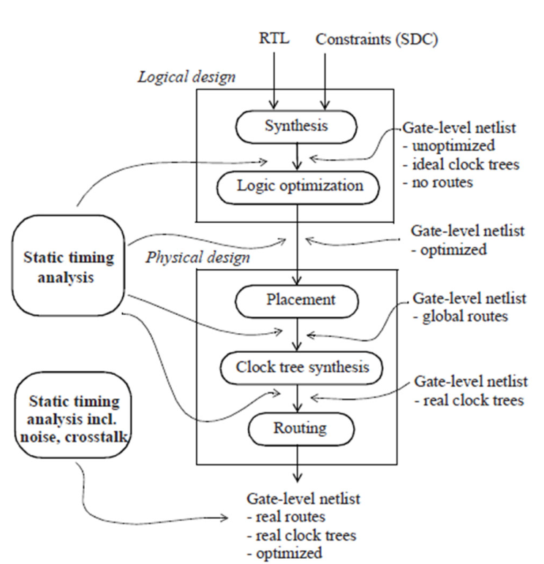
Static Timing Analysis(STA)
Static timing analysis (STA) is a method of validating the timing performance of a design by checking all possible paths for timing violations.
STA is essential for ensuring a circuit’s performance and reliability.
It helps detect timing violations, such as setup and hold violations, that can lead to functional errors. By analyzing timing paths, STA assists in optimizing design speed, minimizing delays, and ensuring functional correctness.

Slide 14
How Does STA Work?
To perform STA, the following three main steps are carried out:
Partition the design into timing paths
– Identify all start points, end points, and intermediate logic that form each timing path.
Compute propagation delays for each path
– Determine how long signals take to travel through gates, nets, and sequential elements.
Check timing constraints for violations
– Verify setup, hold, and other timing requirements at all internal nodes and I/O interfaces.

Slide 15
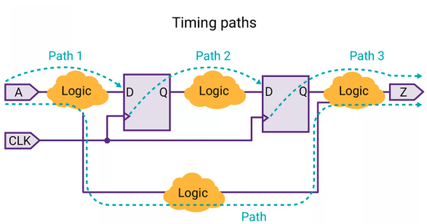
Timing Paths
Each timing path consists of the following elements:
Startpoint: The start of a timing path where data is launched by a clock edge or where the data must be available at a specific time. Every startpoint must be either an input port or a register clock pin.
Combinational logic network: Elements that have no memory or internal state. Combinational logic can contain AND, OR, XOR, and inverter elements, but cannot contain flip-flops, latches, registers, or RAM.
Endpoint: The end of a timing path where data is captured by a clock edge or where the data must be available at a specific time. Every endpoint must be either a register data input pin or an output port.
The following figure shows the timing
paths in a simple design example:

Slide 16
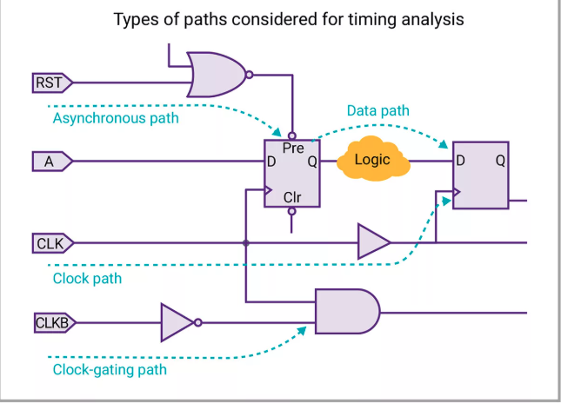
Timing Paths
STA also considers the following types of paths for timing analysis:
Clock path: A path from a clock input port or cell pin, through one or more buffers or inverters, to the clock pin of a sequential element;
  for data setup and hold checks.
Clock-gating path: A path from an input port to a clock-gating element;
  for clock-gating setup and hold checks.
Asynchronous path: A path from an input port to an asynchronous set or clear pin of a sequential element;
  for recovery and removal checks.

Slide 17
Timing Paths
Launch Path (Data Path): The path where data is launched from a flip-flop or register.
Capture Path (Clock Path): The path where data is captured by a flip-flop or register.
Longest Path ( also known as Worst Path, Late Path, Max Path, Maximum Delay Path )
Shortest Path ( Also Known as Best Path, Early Path, Min Path, Minimum Delay Path )
Critical Path: The path in a circuit that takes the longest time for data to travel from one flip-flop to another.
Single-Cycle Path: A single-cycle path is a timing path where data must travel from the launch flip-flop to the capture flip-flop within one clock cycle.
A multi-cycle path is a timing path where data is allowed more than one clock cycle to reach the capture flip-flop.
False path: The path that physically exists in the design but will never be functionally used, so its timing does not need to meet timing constraints.

Slide 18
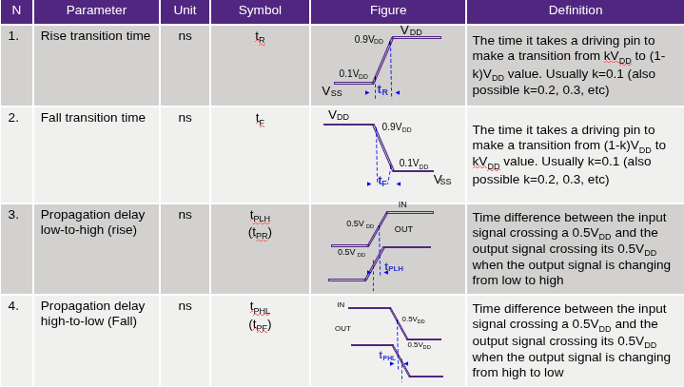
Cell Timing Parameters

Slide 19
Slack is the difference between required time and arrival time.
If required time > arrival time:
  Positive slack
  Indicates that timing constraints have been met.
If required time < arrival time:
  Negative slack
  Indicates that timing constraints have not been met.
  Leads to setup/hold violations
Clock skew: The difference in arrival times of the clock signal at any two flops which are interacting with one another is referred to as clock skew.
Clock jitter refers to the uncertainty in the clock signal’s edge due to noise or process variations.
Slew rate is defined as a rate of change.
  Slew is typically measured in terms of the time it takes a signal to transition between two specific levels.

Slide 20
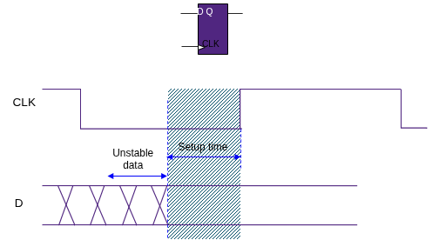

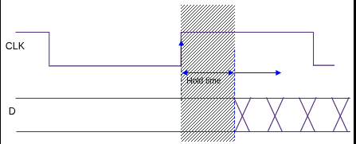

Setup time
  The minimum amount of time during which data signal should be stable before the clock makes a valid transition.
Hold time
  The minimum amount of time during which data signal should be stable after the clock makes a valid transition.

Slide 21
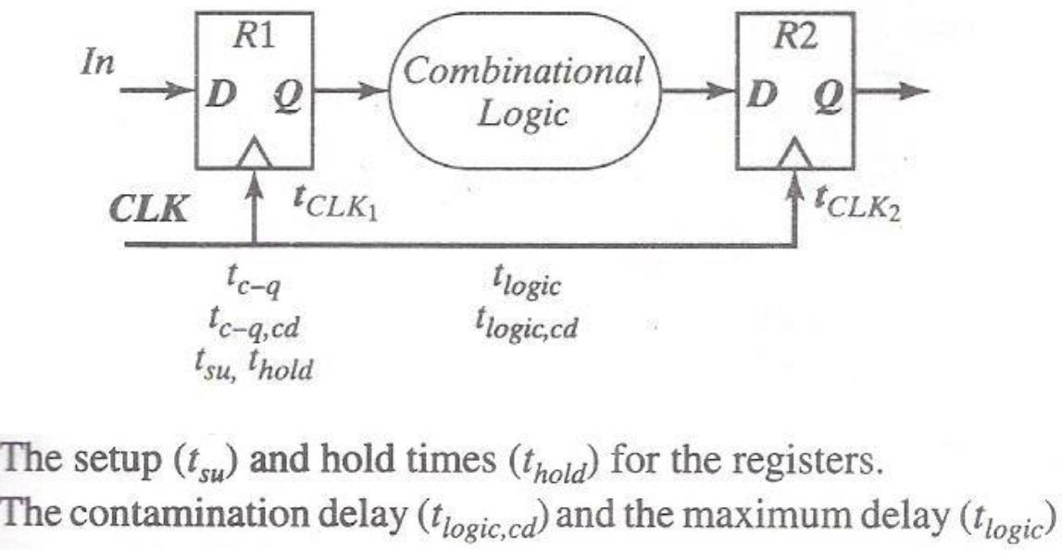
Example
Detailed Example (Step-by-Step)
Given (all values in ps)
t(c→q) = 100 ps
t_logic = 200 ps
t_su = 50 ps
δ = 20 ps
J = 10 ps
t(c→q,cd) + t(logic,cd) = 150 ps

Slide 22
Setup Calculation
  Equation: T ≥ t(c→q) + t_logic + t_su − δ + J
  Computation: 360 ≥ 100+200+50-20+10
Result:
  T_min = 340 ps
  If T = 360 ps → slack = 360 − 340 = 20 ps (safe)
Hold Calculation
  Equation: t_hold < t(c→q,cd) + t(logic,cd) − δ − J
  Computation: t_hold < 150−20−10
  Requirement: t_hold < 120 ps
Examples:
If t_hold = 100 ps → 100 < 120 ✔ Hold satisfied
If t_hold = 125 ps → 125 < 120 ✘ Hold violated

Slide 23
Ways to fix setup violations
Gate Sizing:
  This refers to upsizing the cell to a higher drive strength cell.
  If a low driving strength cell is driving a higher load, it results in higher cell delay.To fix this, one can upsize the cell which will reduce cell delay and helps to meet the setup time.
Vt Swapping:
  The HVT cells in the data path can be swapped to LVT cells which have lesser delays for improving the arrival time.
  This method of fixing setup is also known as threshold voltage swapping. There are three different flavors of a cell – HVT, SVT, and LVT. HVT cells have high threshold voltage whereas LVT cells have low threshold voltage.
  LVT cells require less voltage to turn ON, resulting in lesser cell delay.

Slide 24
Ways to fix setup violations
Reduce Buffering in the Path
  Reduce the amount of buffering (number of buffers) in the signal path.
  If a low driving strength cell is driving a higher load, it results in higher cell delay.To fix this, one can upsize the cell which will reduce cell delay and helps to meet the setup time.
Replace Buffers with 2 Inverters Placed Farther Apart
  Adding an inverter reduces transition time by roughly 2× compared to a buffer.
  Lower transition time → reduced RC (interconnect) delay on the wire.

Slide 25
Ways to fix hold violations
By Adding delays
  Adding buffer / inverter pairs / delay cells to the data path helps to fix the hold violation.
Decreasing the size of certain cells in the data path
  It is better to reduce the cells closer to the capture flip-flop because there is less likelihood of affecting other paths and causing new errors.

Slide 26
Thank You !

